Slide 1


DATA ANALYSIS WITH THE ELASTIC STACK
Mišo Mijatović
Security DevOps @ Sorint.SEC

Slide 2












ELASTIC STACK

Slide 3

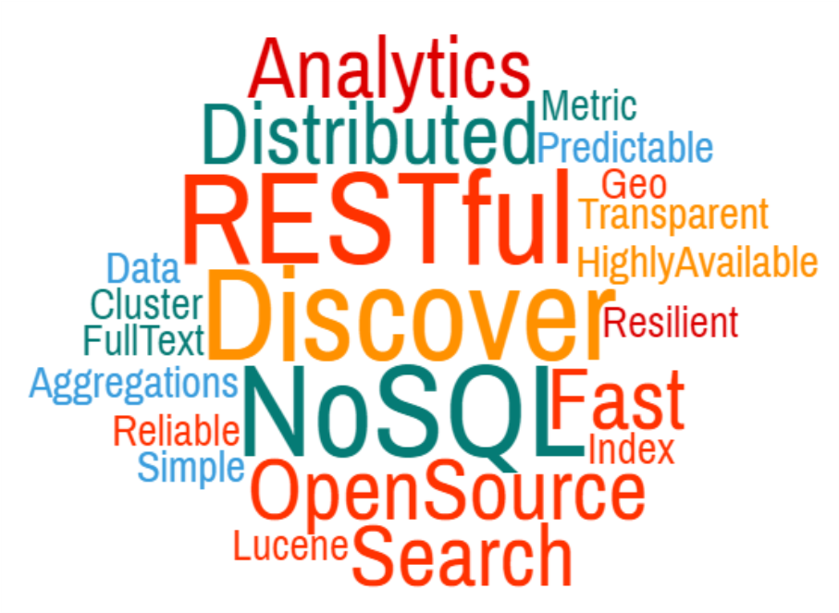
ELASTICSEARCH: WHAT
Distributed data storage & information retrieval platform
Search engine / aggregation engine / analytics
Suggestions / percolation / highlighting / geo
Document store
Horizontally distributed
Highly available
Real time & near real time
Open Source
Apache License
Proprietary plugins available for security & messaging
Simple RESTful API
Fast document retrieval
Versatile - Many popular use cases
Log data analysis
Event data
Full text search
Analytics & Aggregations
Data visualization w/ Kibana
Alerting & classification w/ Percolator
Suggestion engine

Slide 4
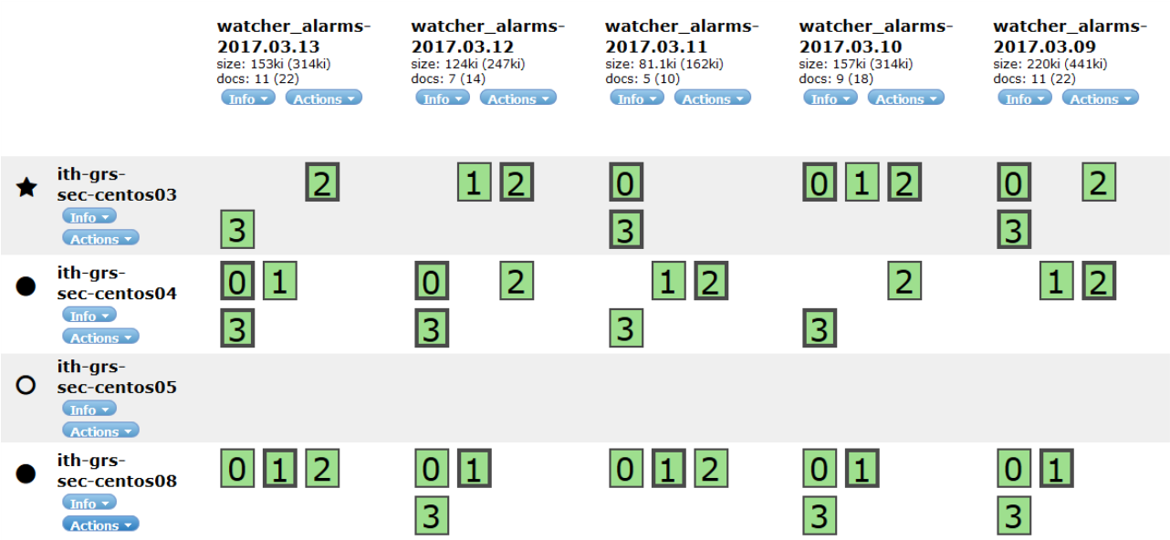
ELASTICSEARCH: HOW
INDEX:
• Container of data
• Document -> indexed
• Each node hosts indices’ shards
DOCUMENTS
• JSON objects
• Contains metadata
• Contains raw data
NODE:
• Es instance
• Contains only data assigned to it
CLUSTER:
• Horizontal scale
• Multiple es instances
• Distributed
• Ports 9300 9200
SHARD:
• Piece of index
• Standalone Lucene index
• Either primary or replica

Slide 5
ELASTICSEARCH: MORE INFO
Shards replication
Cluster status: green yellow red
Node types: master, data, client, …
Mappings & Templates
Aliases
Documents are JSON objects
_source contains the raw data
Every document also contains metadata
Elasticsearch Datatypes
String - "Hello!"
Number - 42
Geopoint / Geoshape - [52.3751349, 4.8694318]
Bool - true | false
Date - 1979-01-10 06:33:03
IPAddress - 54.149.131.206
Object - {"person": {"name":"Joe Smith", "age":37} }
REST APIs POST, GET, PUT, ...
_cat _cluster _search _script _analyze
_template _mapping _alias
_settings _stats _nodes _segments
And many more...

Slide 6
TEXT ANALYSIS & INVERTED INDEX
The quick brown fox jumps over the lazy dog
Fast jumping spiders
2 | Fast
1 | The
1 | brown
1 | dog
1 | fox
2 | jumping
1 | jumps
1 | lazy
1 | over
1 | quick
2 | spiders
1 | the
2 | Fast
1 | brown
1 | dog
1 | fox
2 | jumping
1 | jumps
1 | lazy
1 | over
1 | quick
2 | spiders
1 | brown
1 | dog
1 | fast
1 | fox
2 | jumping
1 | jumps
1 | lazy
1 | over
1 | quick
2 | spiders
1 | brown
1 | dog
1 | fast
1 | fox
1,2 | jump
1 | lazy
1 | over
1 | quick
2 | spiders
1 | brown
1 | dog
1,2 | fast
1 | fox
1,2 | jump
1 | lazy
1 | over
1,2 | quick
2 | spiders
Tokenizer
Stopwords
Lowercasing
Stemming
Synonyms
...and more
Process pre indexing but also prior to searching!

Slide 7






















LOGSTASH & BEATS
LOGSTASH
Data shipper
Collect
Parse
Transform
Has many plugins out of the box - pluggable
Processing pipeline
BEATS
Lightweight data shipper
Single purpose
Modules
i
aggregate, csv, date, DNS, Elasticsearch
geoip, json, grok, kv, mutate, urldecode,
…. many more

Slide 8

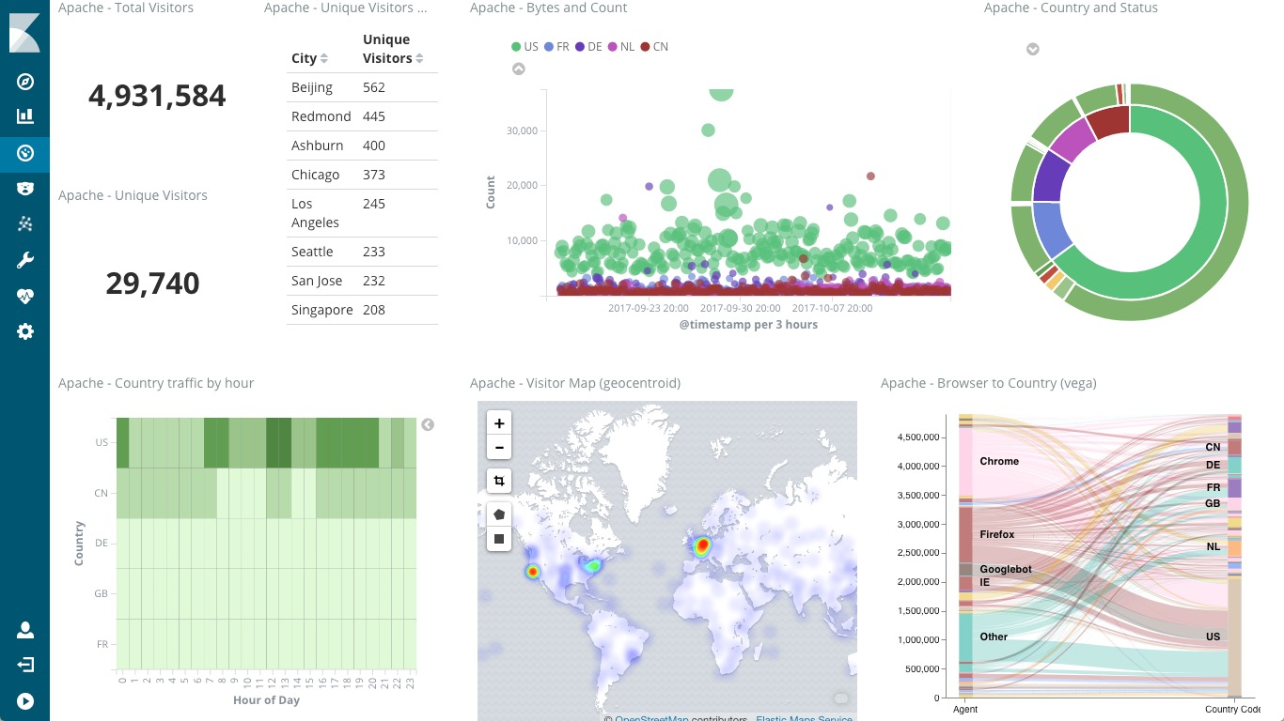
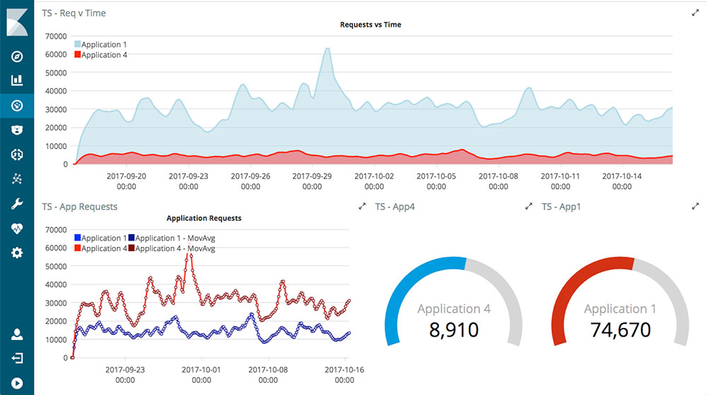
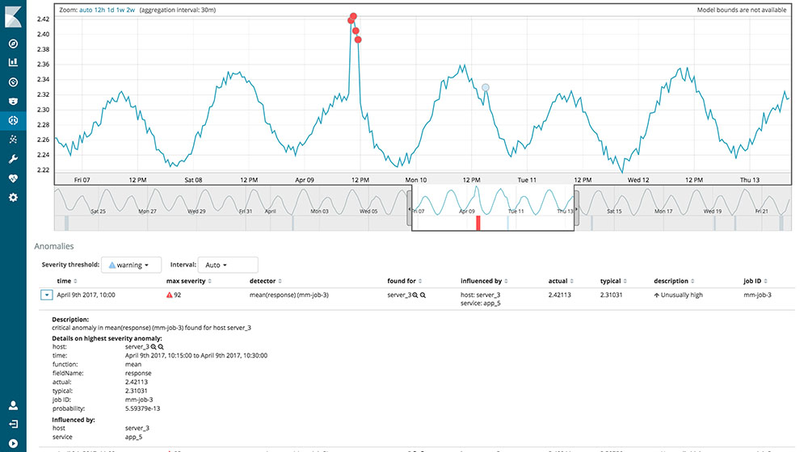
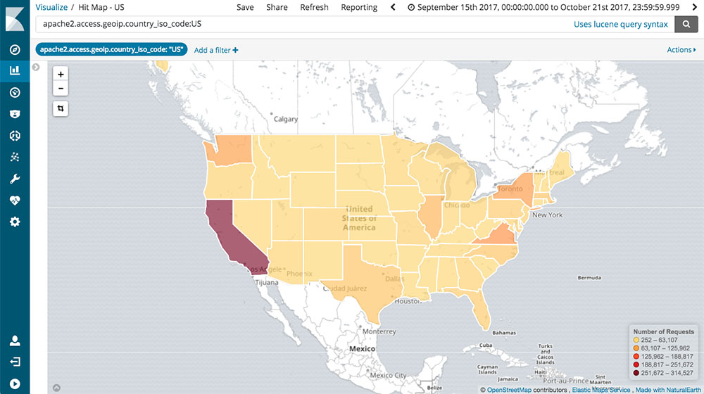
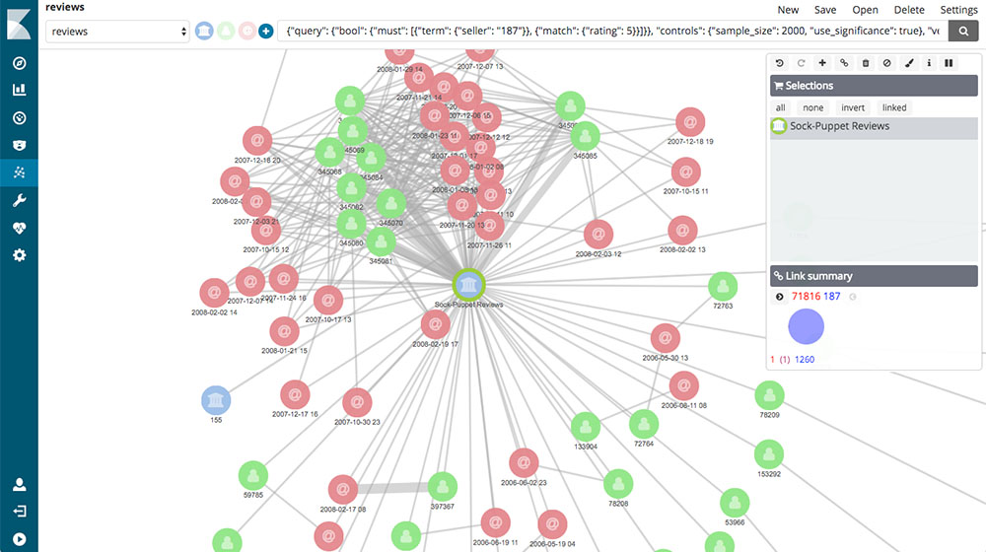
KIBANA
The data visualization framework
Let’s you visualize your Elasticsearch data and navigate the Elastic Stack
Flexible
Pluggable
Dynamic
Powerful
Search!

Slide 9
DEMO

Slide 10

CONTACTS & MORE
ELASTIC
https://www.elastic.co
https://github.com/elastic
https://discuss.elastic.co/
Mišo Mijatović
mmijatovic@sorint.it
misomij@gmail.com
https://github.com/MisoMadao
Dataset by
DEMO HERE:
https://github.com/MisoMadao/download2018
https://www.kaggle.com/misomij

Slide 11
Thanks!
mmijatovic@sorint.it

